Slide 1
FAMEROAD APP
Presentation

Slide 2
Contents
Overview
Login / Registration
Crowd-sourcing
Navigate through POIs

Slide 3
Overview
Each Point of Interest (POI) must belong to three categories:
City: Aigialeia, Gravina in Puglia, Grottaglie
Listing Type: FOOD, ART, MOVE, ENERGY
Category: PRODUCT, PLACE, EVENT, SERVICE

Slide 4
Overview
On the home page the visitor can choose one of the following options:
Search for POIs belonging to a specific Listing Type (1)
Search for POIs belonging to a specific Category (2)
Search for POIs belonging to a specific City

Slide 5
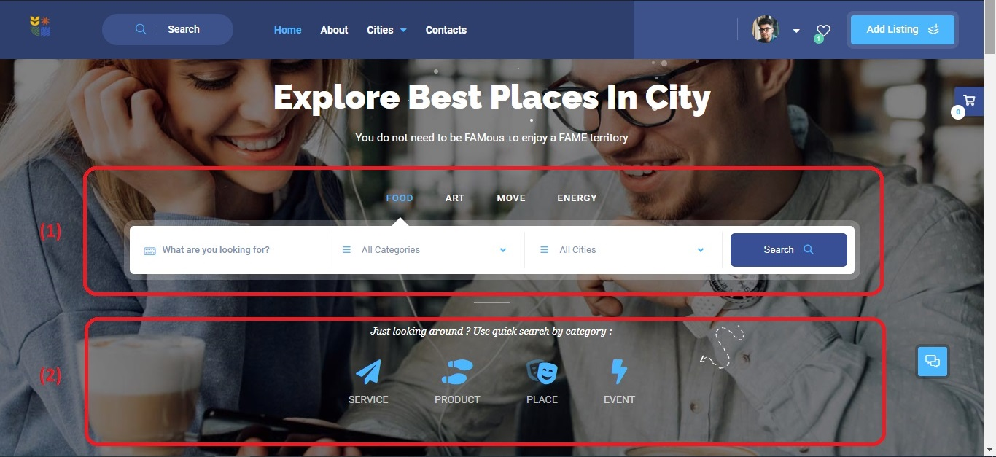
Overview

Slide 6
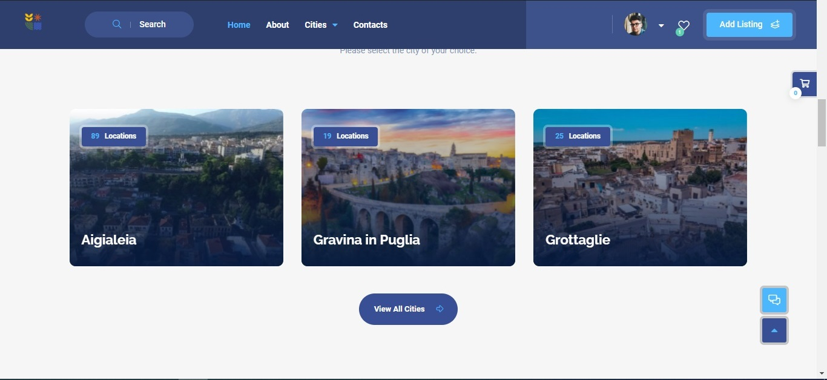
Search for POIs belonging to a specific City

Slide 7
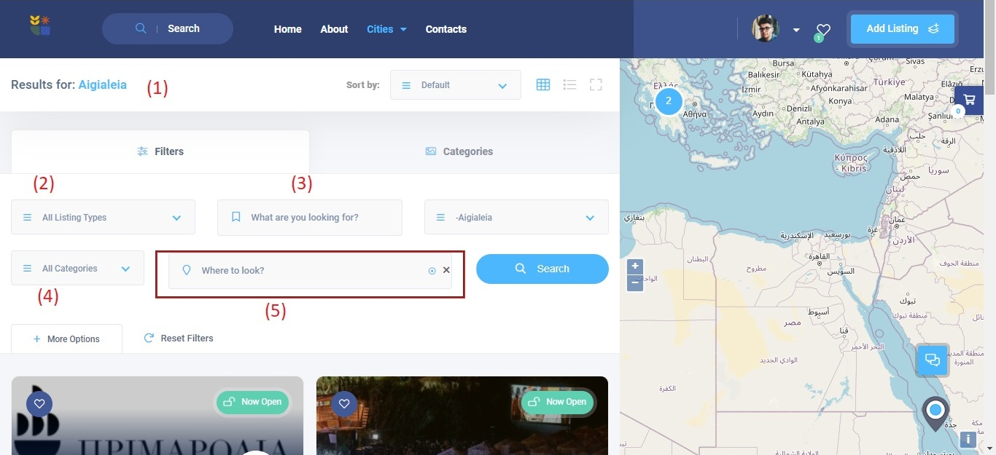
This is the search results page for a City:

Slide 8
This is the search results page for a City:
We are looking for POIs at city "Aigialeia" (1)
We can refine the search by filtering by:
Listing Type (2)
Keyword Search (3)
Category (4)
Geolocation (5)
( Geolocation means making suggestions to users based on where they are and 1-2 km away from them. )

Slide 9
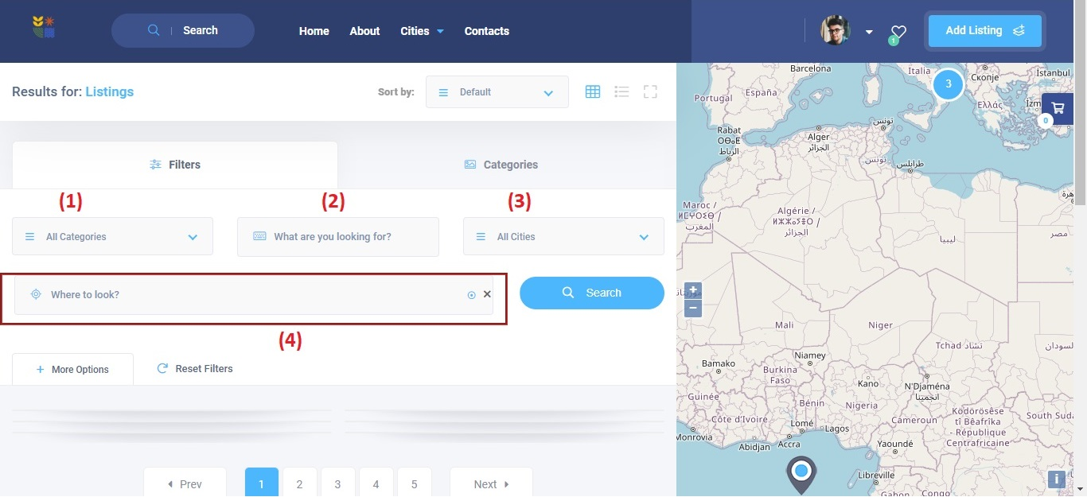
This is the search results page for a Listing Type:

Slide 10
This is the search results page for a Listing Type:
We are looking for POIs related to "FOOD"
We can refine the search by filtering by:
Category (1)
Keyword Search (2)
City (3)
Geolocation (4)
( Geolocation means making suggestions to users based on where they are and 1-2 km away from them. )

Slide 11
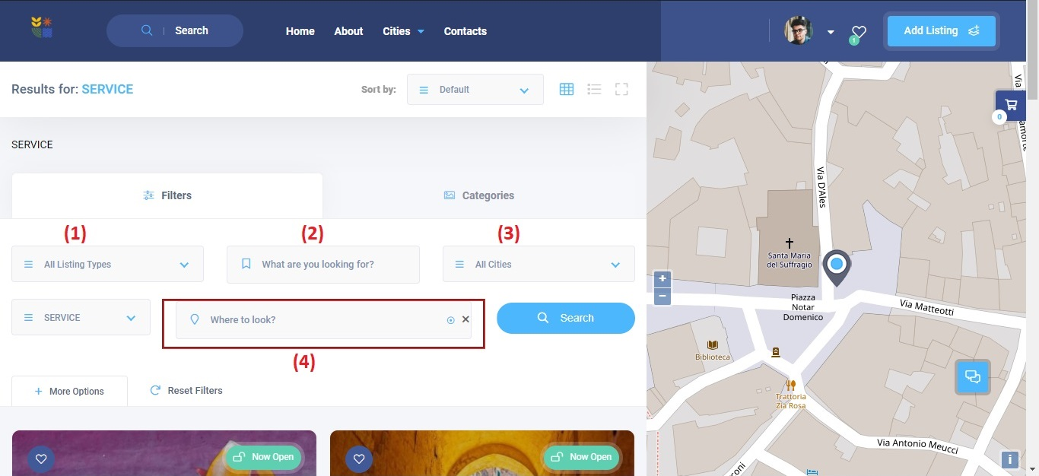
This is the search results page for a Category:

Slide 12
This is the search results page for a Category:
We are looking for POIs related to "SERVICE"
We can refine the search by filtering by:
Listing Type (1)
Keyword Search (2)
City (3)
Geolocation (4)
( Geolocation means making suggestions to users based on where they are and 1-2 km away from them. )

Slide 13
LOGIN / REGISTRATION
Every user belonging to the "listing author" category has the right to enter and manage all POIs he wishes.
User registration can be done in two ways:
Either with the standard wordpress registration process
Either using social media

Slide 14
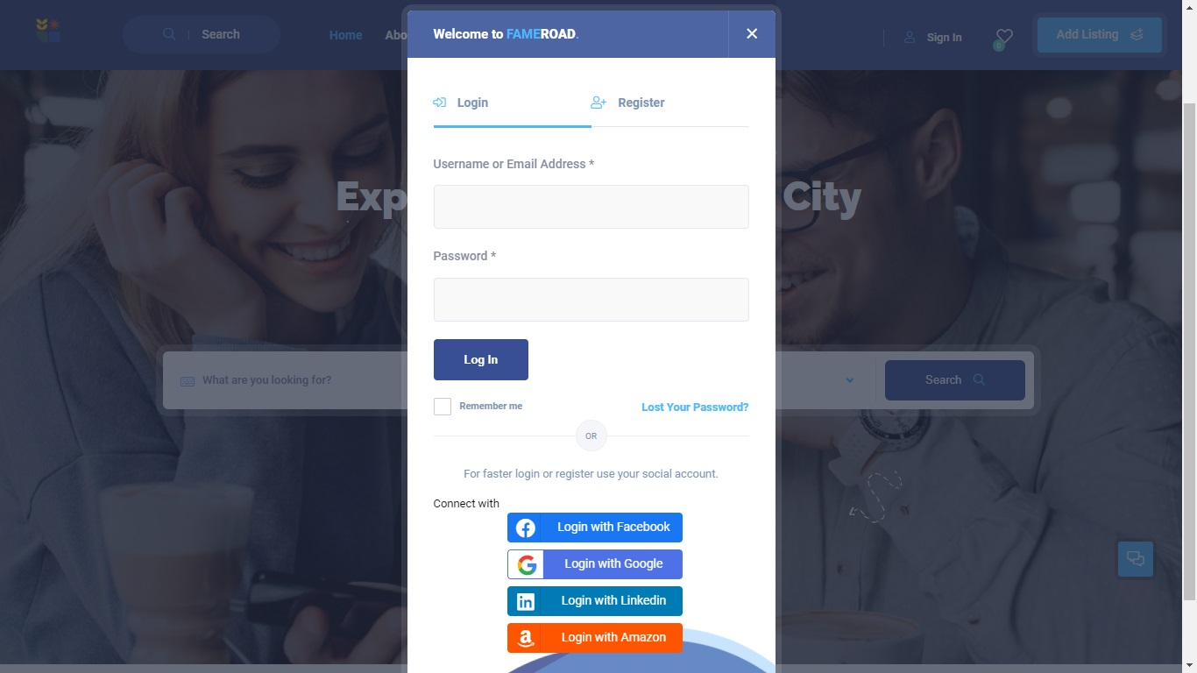
LOGIN / REGISTRATION

Slide 15
Crowd-sourcing
Gathering information from users about their choices (crowd-sourcing):
The visitor can rate a POI (1)
The visitor can add comments on a POI (2)
The visitor can add his/her favorite places

Slide 16
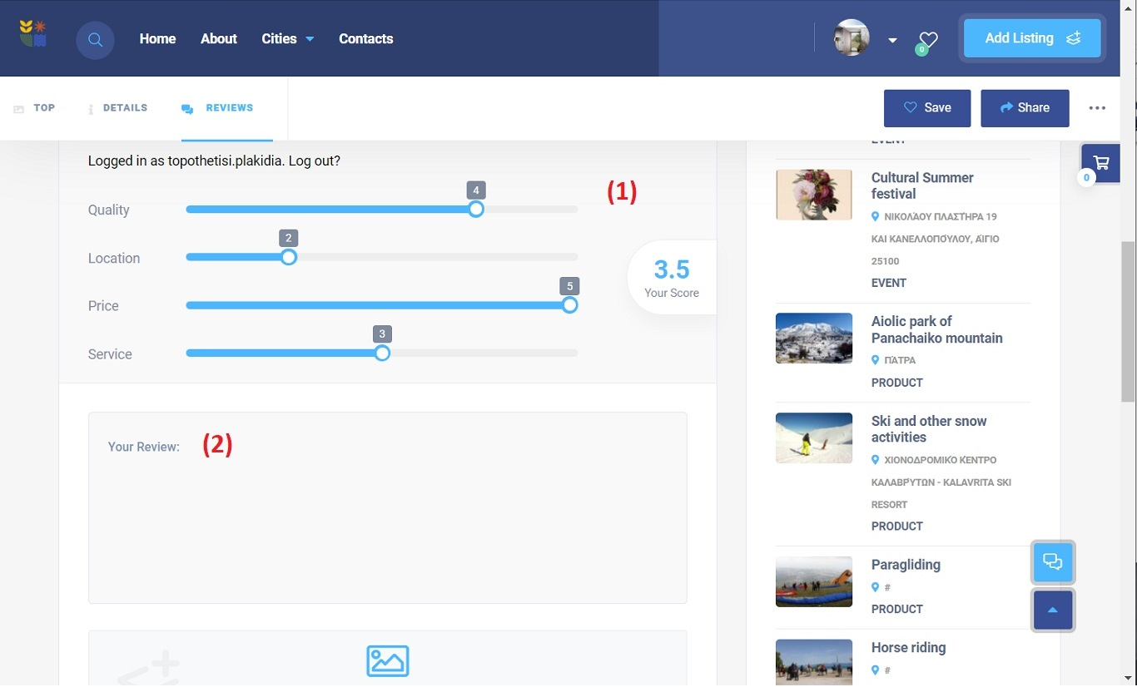
Rate a POI (1) and add comments on a POI (2)

Slide 17
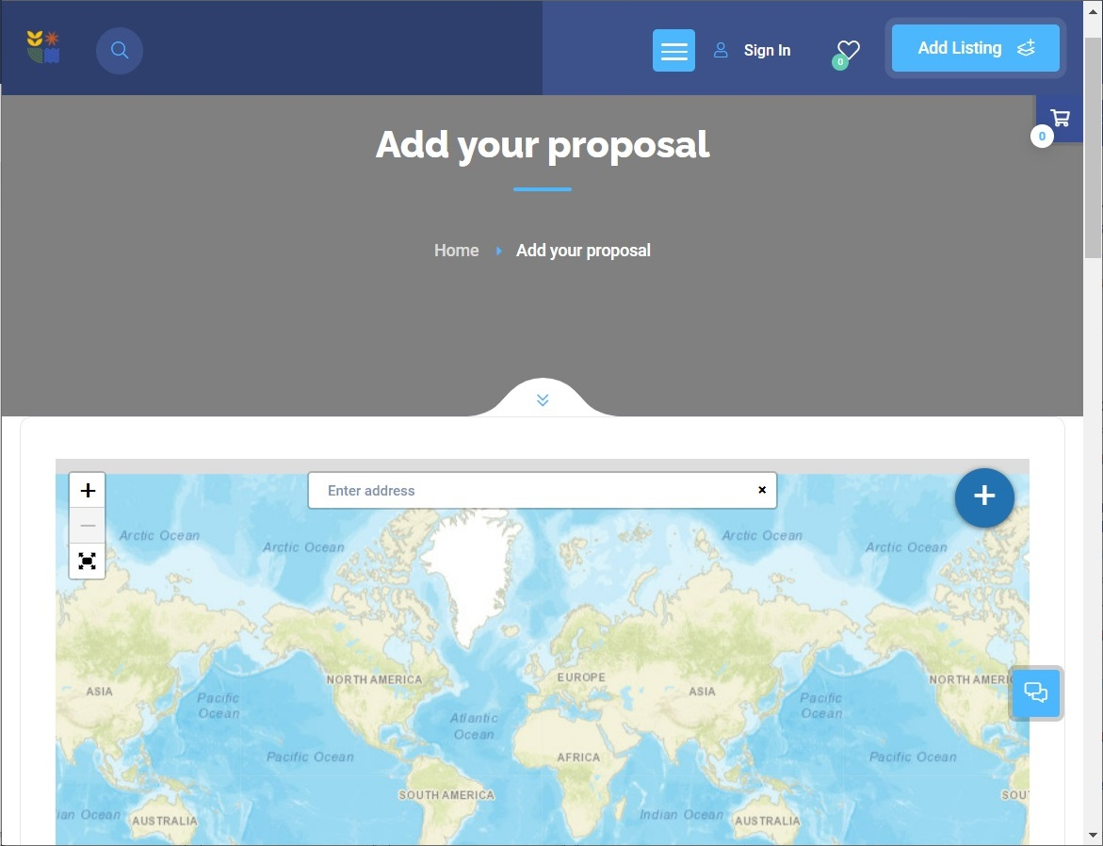
The visitor can add his/her favorite places

Slide 18
Navigate through POIs
The visitor can select POIs and draw a route that connects these POIs.
The visitor can select starting point (1), many waypoints (2) and ending point (3).

Slide 19
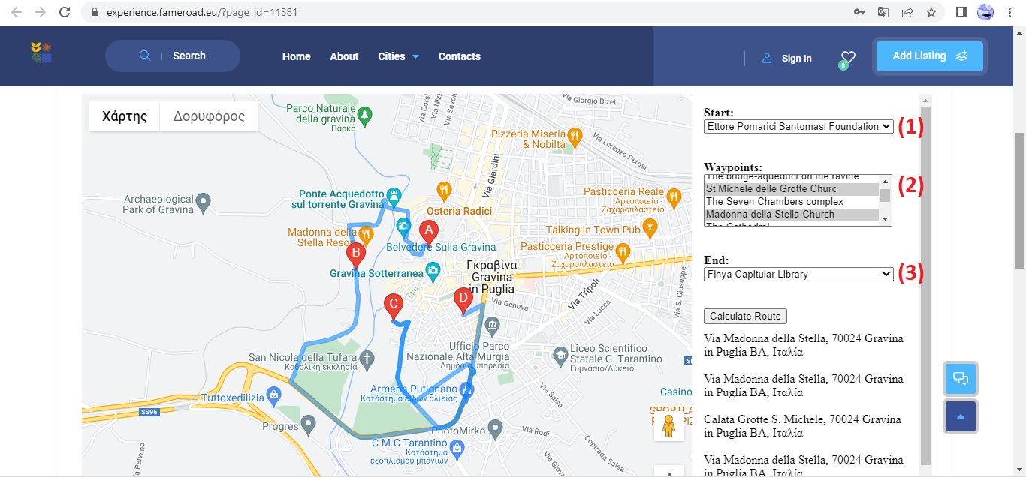
Navigate through POIs

